Slide 1
Figure 1
A
B
C
D
E
F

Slide 2
Supplementary Figure 1
A
B
C
D

Slide 3
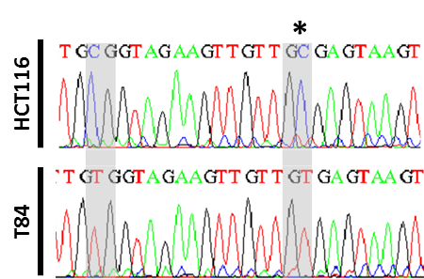
Figure 2
A
E
COLO205
ITGA9
SKCO1
KM12
CO115
T84
IS3
0.01
0.02
0.02
0.79
0.88
0.87
BS sequencing
Microarrays
Un-
Meth
Un-
Meth
Meth
Meth
B
F
COLO205
HCT116
KLHL3
T84
V9P
HCA7
TC71
BS sequencing
0.06
0.05
0.05
0.88
0.88
0.90
Microarrays
Un-
Meth
Un-
Meth
Meth
Meth
C
G
SW1116
HCT116
PPP1R14D
IS2
IS3
CO115
TC71
BS sequencing
0.04
0.04
0.03
0.88
0.89
0.89
Microarrays
Un-
Meth
Un-
Meth
Meth
Meth
D

Slide 4
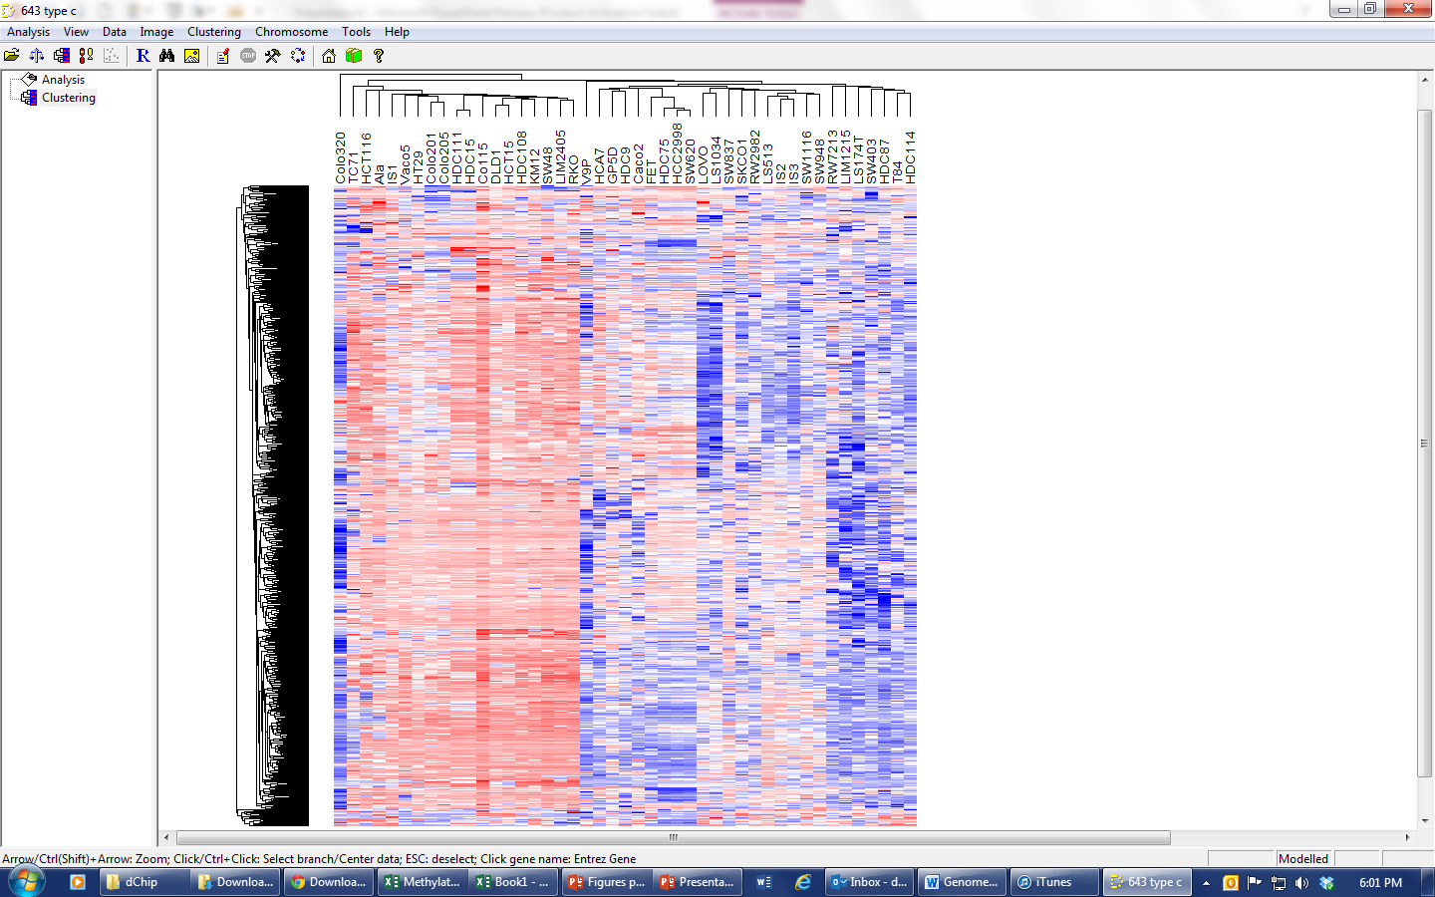
Figure 3
A
B
MSS/MSI
BRAF
CIMP

Slide 5
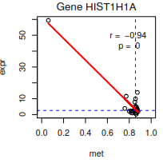
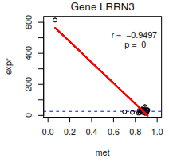
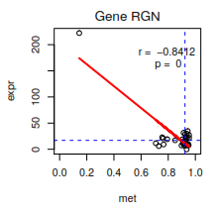
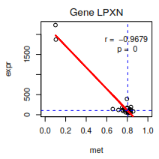
Supplementary Figure 2

Slide 6
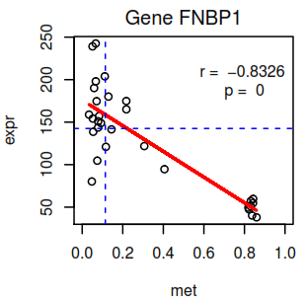
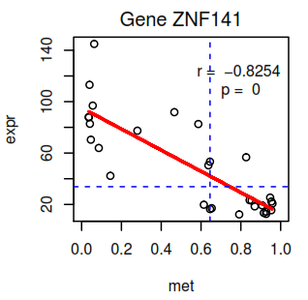
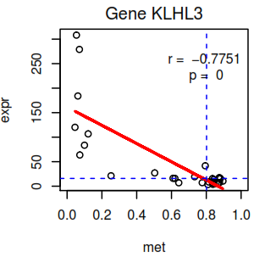
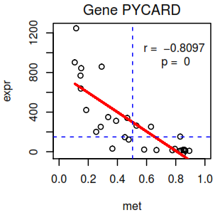
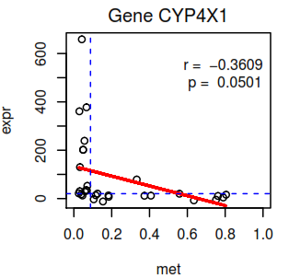
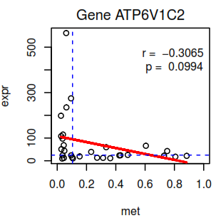
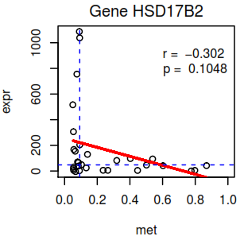
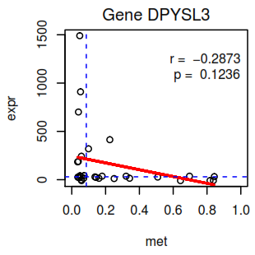
Figure 4
A
B
C
D
E
F
G
H

